Slide 1
Women and Genetically Engineered Machines

Slide 2
Emmanuelle Charpentier
French Researcher
Ph.D. in microbiology at Pasteur University
Director @ Max Planck Unit for the Science of Pathogens
Researched RNAs in the S. pyogenes genome & how the bacteria’s CRISPR system can be used to defend itself against viruses
Nobel Peace Prize in chemistry in 2020 -> CRISPR Technology
“Clustered regularly interspaced short palindromic repeats”
Gene Editing Tool
Used today in agriculture, medicine, etc!
Notes:
Novel - unknown
Ribonucleic acid (RNA) is a molecule similar to DNA. Unlike DNA, RNA is single-stranded. An RNA strand has a backbone made of alternating sugar (ribose) and phosphate groups.

Slide 3
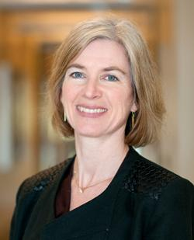
Jennifer Doudna
American Biochemist
Ph.D. Biological Chemistry and Molecular Pharmacology, Harvard Medical School
From Hilo, Hawaii - love beauty of nature
2006 - she was introduced to CRISPR by Jillian Banfield
2012- made a discovery that reduced the time & work needed to edit genomic DNA
Today, part of research faculty at UC Berkeley and highly influential on the ethics of changing genes using CRISPR
Notes:
Novel - unknown
Ribonucleic acid (RNA) is a molecule similar to DNA. Unlike DNA, RNA is single-stranded. An RNA strand has a backbone made of alternating sugar (ribose) and phosphate groups.

Slide 4
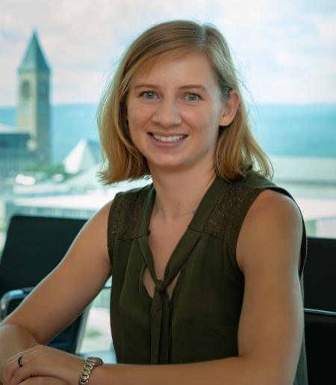
Erin Stache
Synthetic Chemist and Professor of Chemical Biology at Cornell
Ph.D. Wisconsin University, Colorado State University
Currently works on making polymers in bacteria
Increase efficiency by synthesizing new paths
Make the process sustainable

Slide 5
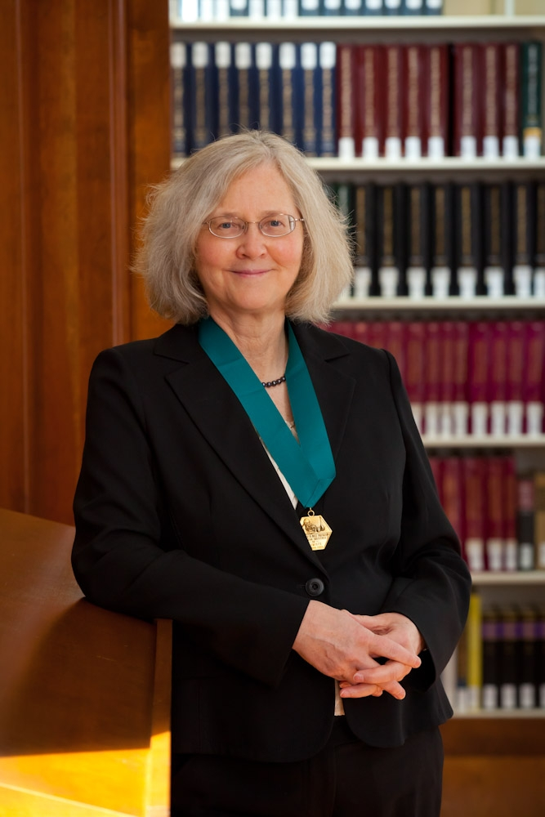
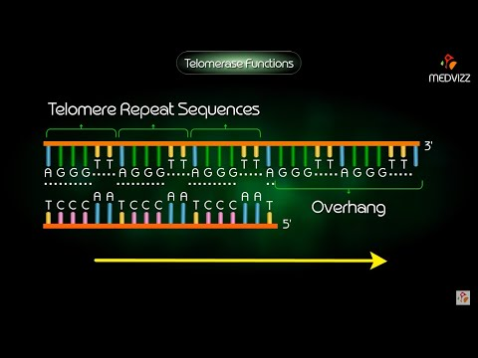
Elizabeth Blackburn
Australian biological researcher: Former president of Salk Institute, researcher at UCSF, member of President’s Council on Bioethics
BSc: University of Melbourne, PhD: University of Cambridge
DNA sequencing methods
Won 2009 Nobel Prize in Physiology or Medicine: First Australian woman
For the discovery of the telomerase: enzyme that replenishes telomeres
Important for aging!
Currently studying the impact of meditation of telomerase
Notes:
PhD: worked with Fred Sanger of Sanger sequencing
Telomerase:
Showed that telomeres are replenish by the enzyme telomerase
This conserves cellular division as to stops the loss of important genetic information→ related to cellular aging
Blackburn describes them like caps on the ends of shoelaces
Adding telomerase to cells without it bypasses the limit of cellular aging, linking the enzyme to reduced cellular aging
Adding telomerase to cancer cells provides an immunity mechanism for the cell in proliferating, linking the transferase activity to increased cellular growth and reduced sensitivity for cellular signaling.
Synthetic biology/genetic engineering application
Very important for the field of molecular biology.
Medical Ethics
Controversially dismissed from the President's Council on Bioethics during Bush Jr’s presidency because she supported human embryonic cell research, in opposition to the Bush Administration.

Slide 6
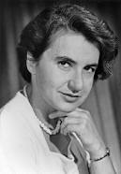
Rosalind Franklin
Rosalind Franklin was a British scientist born in 1920 who contributed to discovering the molecular structure of DNA
Studied physical chemistry at University of Cambridge
Used X-ray diffraction techniques to research the structure of DNA
confirmed it’s double helical structure
her work allowed other scientists to suggest the double helix structure of DNA
Contributed to the war effort in World War II by working for the British Coal Utilization Research Association researching coal and carbon
Notes:
Rosalind Franklin was a British scientist born in 1920 who contributed to discovering the molecular structure of DNA. She studied physical chemistry at University of Cambridge and during World War II briefly worked for the British Coal Utilization Research Association where she helped research coal and carbon to contribute to the war effort. She studied x-ray diffraction research methods and applied this knowledge to DNA which at the time had an unknown structure. Using x-ray diffraction techniques she discovered the density of DNA and confirmed it had a helical structure. Her work helped later scientists better understand DNA and lead to the discovery of DNA’s double helix structure.

Slide 7
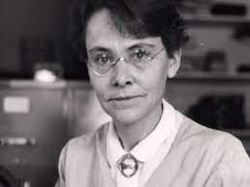
Barbara McClintock
Dr.McClintock won the 1983 nobel prize in physiology and was a Cornell educated revolutionary scientist famous in the field of genetics for discovering transposons:
Studied corn and realized that color differences in kernels were due to “jumping genes”
“Jumping genes” or transposons are DNA sequences that move from one location to another - creating mutations and changing genetic expression
Was ridiculed for going against prevalent theories of that time
However continued to believe in her research and persevered
”If you know you are on the right track if you have this inner knowledge, then nobody can turn you off... no matter what they say.”
Notes:
Barbara McClintock was a groundbreaking scientist who studied chromosomal and genetic expression, and was awarded the 1983 Nobel prize in physiology or medicine. Her work primarily consisted of studying genetic transposition and controlling elements in the genetic expression of maize, which is somewhat like studying how little molecules move around our body like cars moving in traffic. As a woman, she faced multiple barriers in the STEM field, especially because her theories (which were backed up by evidence) contradicted many of the prevailing genetic theories. She was labeled as being “crazy,” and stopped publishing due to the backlash. However, she stayed steadfast in her beliefs and continued her research. After years, as other scientists started to come to similar conclusions, she was finally given credit for her revolutionary theories. As one of the foremost female scientists in a field that discounted her time and again, we can learn from her quote,”If you know you are on the right track if you have this inner knowledge, then nobody can turn you off... no matter what they say.”

